Slide 1
REACT FRONT END

Slide 2
Hi! Welcome to REACT workshop
Follow these steps:
Clone repo: https://github.com/FullstackAcademy/Study-Saturday-Week3
createDB study-saturdays
npm install
npm run seed
git checkout cycle-1

Slide 3
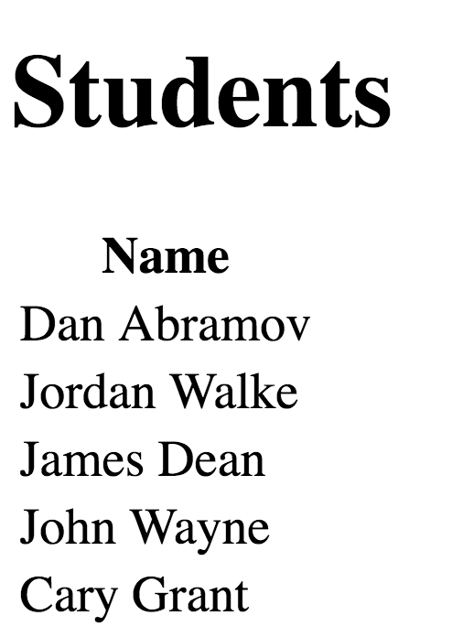
Cycle-1 : Show list of all Students
End Goal is to show list of all the students that are stored in the DB
To start checkout cycle-1 branch: git checkout cycle-1
Instructions:
In browser/ index.js
import `React` and `ReactDOM` and use the latter to render a heading that says “Hello React!”
Create a components folder in the browser folder.
In that new components folder, create a <Main> component that fetches a list of all students from the server. It should render a table of students with one column, the student’s full name
Review at 12:00pm

Slide 4
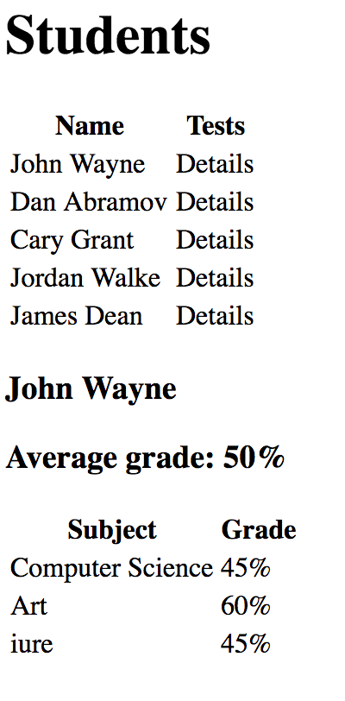
Cycle-2 : Shows Individual Student’s Details
End Goal: to shows students first name, last name , average grade and each subject grade once you click on the details link
To start checkout cycle-2 branch: git checkout cycle-2
Instructions:
Create StudentList.js component which will map and render each student.
Add a second column to the table.
In the second column, add a word like “Details”, that, when clicked, renders all of that student’s test scores below the table
Create SingleStudent.js component which will show students name and average score along with each test and grade
Review at 3:30pm

